Slide 1
ASP.NET Core Internals

Slide 2

ASP.NET MVC IS MAGICAL

Slide 3

Or maybe not…
It's time to look behind the curtain

Slide 4
CreateBuilder()
The CreateBuilder: method is another piece of "magic" that we will dive into. It makes the setup of your app easier by pre-configuring the features that almost every app will use.
This may be slightly out of date, but will still be similar to the following:
var builder = new WebApplicationBuilder()
.UseKestrel() //Tell it to use Kestrel as the application server
.UseContentRoot(Directory.GetCurrentDirectory()) //Set up the application root directory
.ConfigureAppConfiguration((hostingContext, config) => { /* setup config, more on this later */ })
.ConfigureLogging((hostingContext, logging) => { /* setup logging, more on this later */ })
.UseIISIntegration() //When executed through IIS, configure a dynamic port for Kestrel to use
.UseDefaultServiceProvider((context, options) => { /* setup the dependency injection (DI) container*/ })
.ConfigureServices(services =>
{
//Add settings for Kestrel to the DI container
services.AddTransient<IConfigureOptions<KestrelServerOptions>, KestrelServerOptionsSetup>();
});

Slide 5
Middleware
Middleware is software that's assembled into an app pipeline to handle requests and responses. Each component:
Chooses whether to pass the request to the next component in the pipeline.
Can perform work before and after the next component in the pipeline.

Slide 6
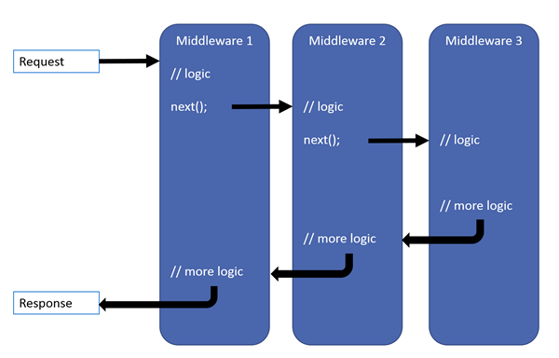
Request Pipeline

Slide 7
Pre-Built Middleware to Try
Here's a few, but there are MANY more. You can also write your own
//Allow plain files to be served. These come from wwwroot by default, but can be configured to look for them elsewhere
app.UseStaticFiles()
//When an exception occurs, show error details for debugging. This gets added automatically as of ASP.NET 6
app.UseDeveloperExceptionPage();
//Similar to above, except gives better formatting for database errors from EntityFramework
app.UseDatabaseErrorPage();
//Redirect the user to a specific location when an error occurs
app.UseExceptionHandler("/Home/Error");
//Redirect requests from "http" to "https"
app.UseHttpsRedirection();

